Slide 1
INVESTMENT ANALYSIS Visualization
By: AJAY SINGH

Slide 2
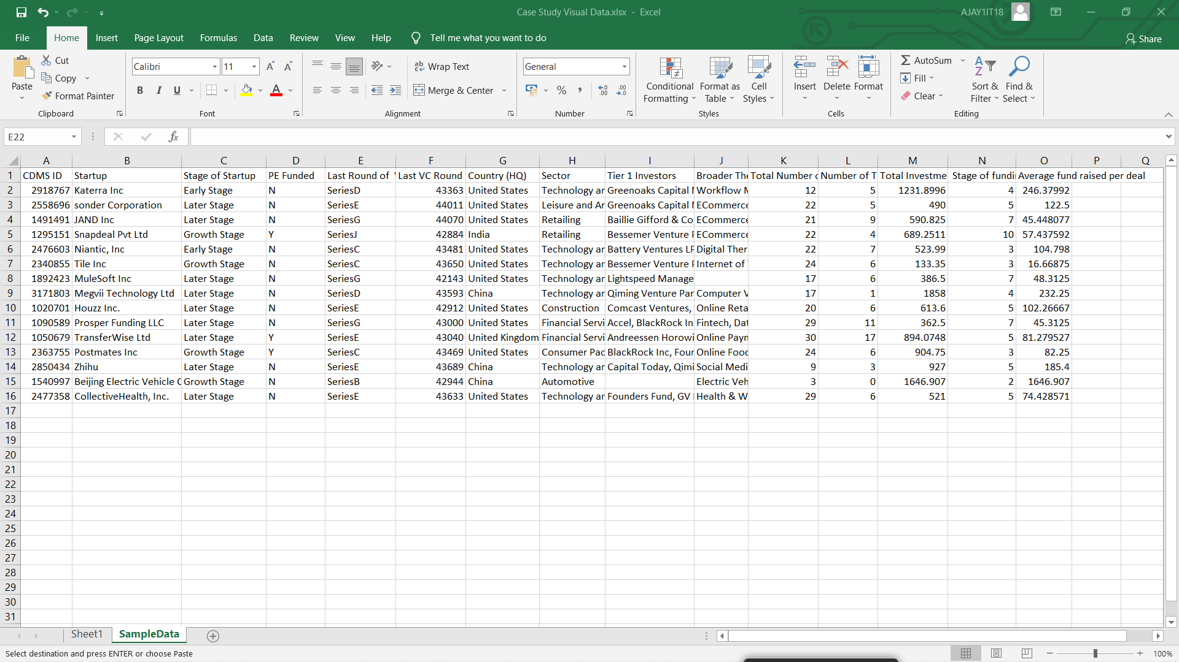
Sample Data :

Slide 3
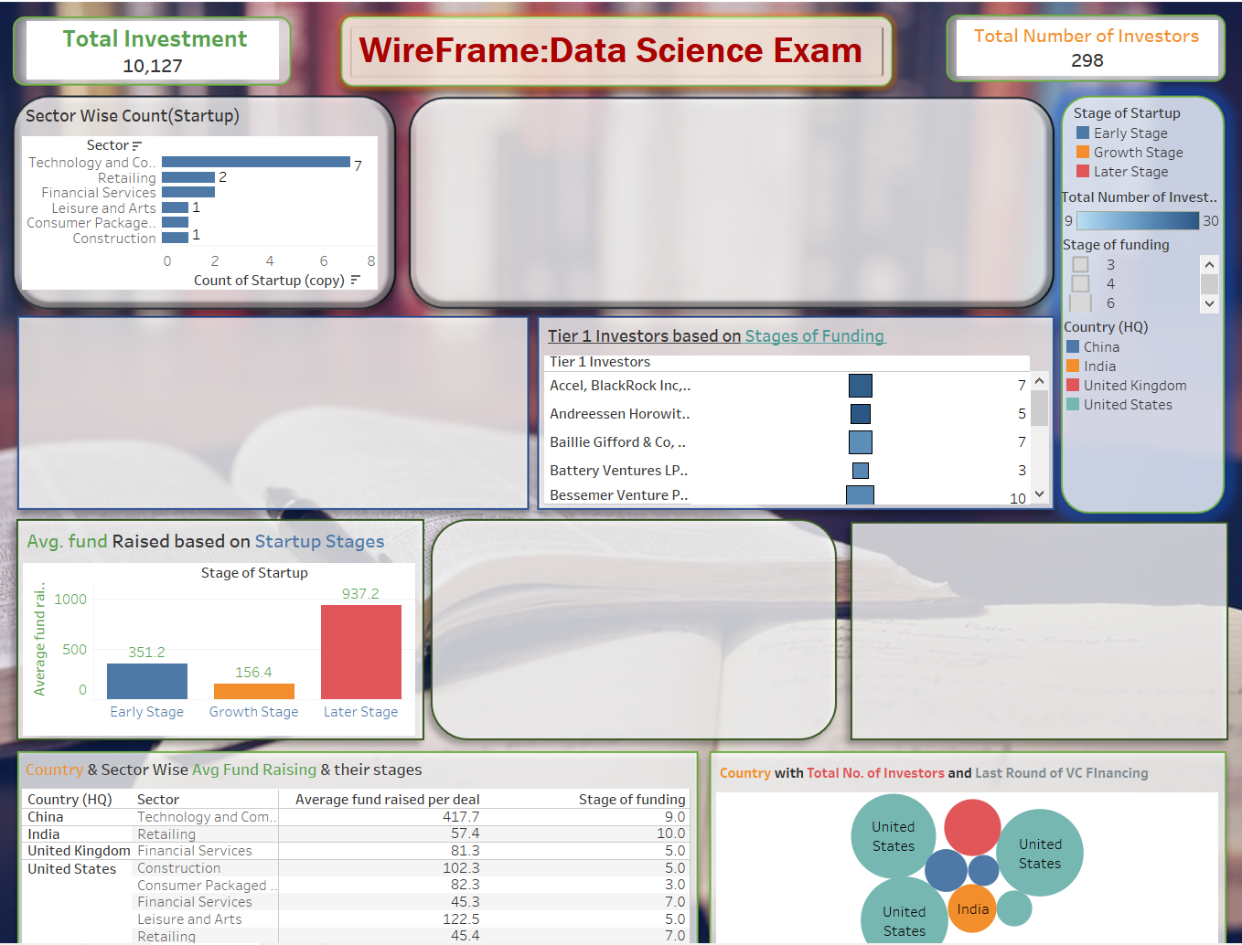
Wireframe

Slide 4
KPI’s: 1. Total Investment: 10,127 2. Total No. of Investors: 298
Charts based on The sample data :
Sector wise Count(Startup)
Tier 1 Investors based on stages of Funding
AVG. fund Raised based on Start up of stages and etc.

Slide 5
Estimate of Project:
By Top-Down Estimation : Breaking into parts by work
Project Estimation based on these :
Dashboards
Story
Insights of the dashboards
Creative Viz of Dashboards
Multiple No. of Sheets
Creative Designing of sheets
Wireframe
Data Cleaning

Slide 6
18% G.S.T Is not included in this estimate.
Steps to Perform | Hours Taken by specific Task | Cost of 1 hour for specific Task (Rs) | Total cost
Gathering of data & Cleaning | 1.5 hours | 400 | 600
Data Analysing | 2 hours | 450 | 900
Creating KPI | 1 hour | 300 | 300
Creating Wireframe | 4 hours | 700 | 2800
Creating Sheets | 5.5 hours | 450 | 2475
Creating interactive Dashboards | 5 hours | 650 | 3250
Creating Stories | 2 hours | 400 | 800
Insights & Conclusion | 3 hours | 500 | 1500
Total Estimate | 24 hours |  | Rs 12,625 /-

Slide 7

How to Use Dashboard:
ANIMATION are used in Tableau for creating beautiful view .
The investment is denoted by an image and the size of the icon will depict the how large the value is .
The Dashboard contains few KPI ’s which will help you analyzing your data effectively
Whenever you hover on a chart ,you will see the respected data of that particular field.
Go To Sheet Buttons are used to go directly to the main sheet By using ALT + CLICK
The separate field is provided on the right side from where you can control the data with the help of sliders and some small charts are mentioned for taking the references.
Specific colors are assigned for their specific labelling for ease.

Slide 8
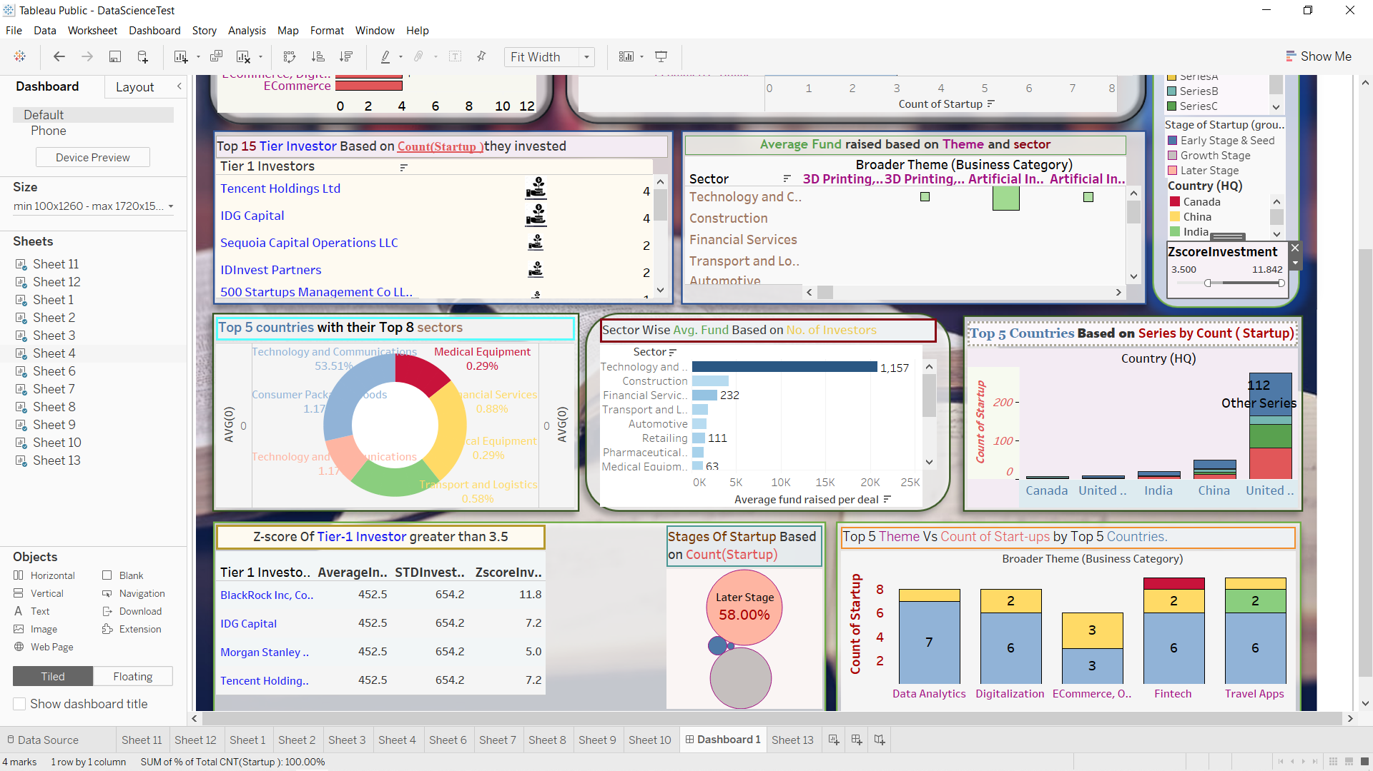
By Following the given Instructions you will be able to use dashboards properly
Use of filters are done for better viewing of data.
Different Colours for different Fields:
Red : Count( Start up)
Purple :Theme
Blue: Tier-1 Investors
Light Blue: Countries
Brown: Sectors, Etc.
For getting Z-Score values , a slider on right top is provided
to select the Tier-1 investors based on their respective z-score values.

Slide 9
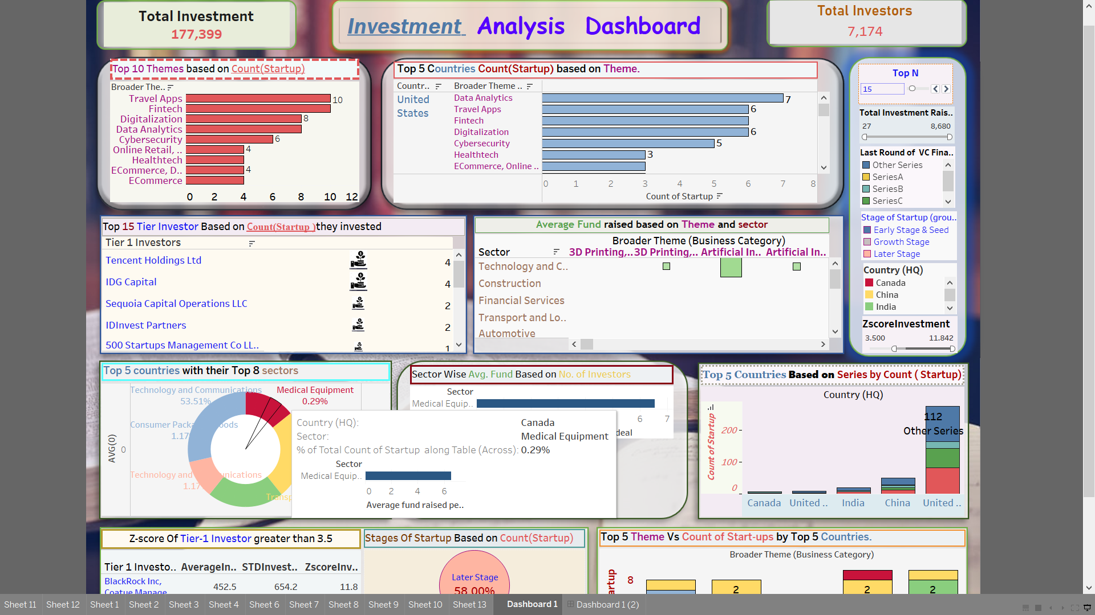
Dashboard Preview:

Slide 10
Insights from the Dashboard
Based on the given Data we can conclude that:
Total Investors are 7174.
Total Investment done is 177,399.
Travel Apps and Fintech are the best 2 best Themes based on no. of Startups .
The count(Startup) for them is 10 each.
Tensing Holding Ltd and IDG Capital are the top 2 Tier-1 Investors based on their Start-up count with a value of 4.
Sequoia Capital Operations LLC & IDInvest Partners have 2 -2 Start-up each.

Slide 11
Based on Country, United States has maximum no. of Start-ups around 276.
Canada has the minimum of Count(Startup) among the top 5 Countries Based on Theme.
Spain , Georgia, Finland & Indonesia have the minimum Count (Start-up ) of all the countries.
In United States Max. of 82 Startup are In the Stage D , followed by Series C with 61 and 21 with Series B and other Series sum up to 112.
Canada has Minimum no. of Startup with 1 in Series C , 2 In Series D & 5 in Series B.
Maximum Average Fund raised per Deal by the Construction sector With value of 3699. and Minimum Average Fund raised per deal is 4 by Technology & Communication Sector.
Technology & Communication Sector has maximum of 53.51% of Count of Startup in US from the Top Country.

Slide 12
58% of Start-up are in their Later Stage
38% are in Growth Stage
3. 5 % in Early Stage and 0.5% are in Seed Stage.
US & China has 3 Startup in E-Commerce , Retail.
Canada has 1 startup in Fintech.
India has 2 Startup in Travel Apps.
THANK YOU …

